Slide 2
Targeted metabolomics related to vitamin status, nutrition, lifestyle and inflammation

Slide 3
Overall activities
Measurement of direct and functional biomarkers in serum, plasma, CSF and urine
The biomarkers are related to vitamin status, nutrition, lifestyle and inflammation

Slide 4
Strategy
1. Targeted metabolite profiling
2. Complementary biomarkers allocated to dedicated platforms (A – H)
3. Metabolic profiling tailored to large epidemiological studies
  Low volume requirement (< 100 µL)
  Multiplexing.
  High sample throughput and analytical capacity.
  Optimized exploitation of the biobank resources
  (optimizing logistics, no/few thawing-freezing cycles, metabolite ratios across platforms etc)
4. Authentic internal standards
5. Knowledge of preanalytical stability
6. Intra-class correlation coefficient
7. Biomarker profiles that comprehensively cover defined pathways and metabolite networks
8. Analyses of biomarkers of common confounders in epidemiological research

Slide 5
1. Targeted metabolite profiling

Slide 6
Metabolomics
Untargeted. Hypothesis generating, but captures only abundant metabolites and with the inherent weakness of low capacity, low precision, possible assay interference and misidentification
Targeted, semiquantitative, including a few, non-authentic internal standards, generating concentrations in terms of relative intensities
Targeted, quantitative, including authentic isotope-labelled internal standards for all metabolites, which is paramount to obtain adequate precision and absolute concentrations

Slide 7
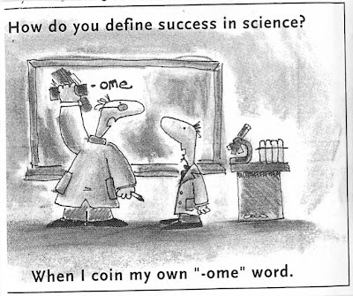

Slide 8
Targeted metabolomics versus
untargeted metabolomics

Slide 9
Definitions and illusions
Definition of metabolomics
“To measure the metabolome, which represents the collection of all metabolites in a biological cell, tissue, organ or organism, which are the end products of cellular processes”.
The Illusion
“An ambitious goal of some of this research is to monitor the level and modification of all proteins and metabolites in a biological sample such as plasma. --- but the presently available tools are clearly not sufficient for these very difficult tasks” Marvin L. Vestal (J. Am. Soc. Mass. Spectrom. ).
Targeted metabolomics, metabolic profiling,
To quantify a defined set of metabolites and biomarkers within a biological system (system biology)

Slide 12
Anal Chem (2011) 83:14, 5735-40

Slide 13
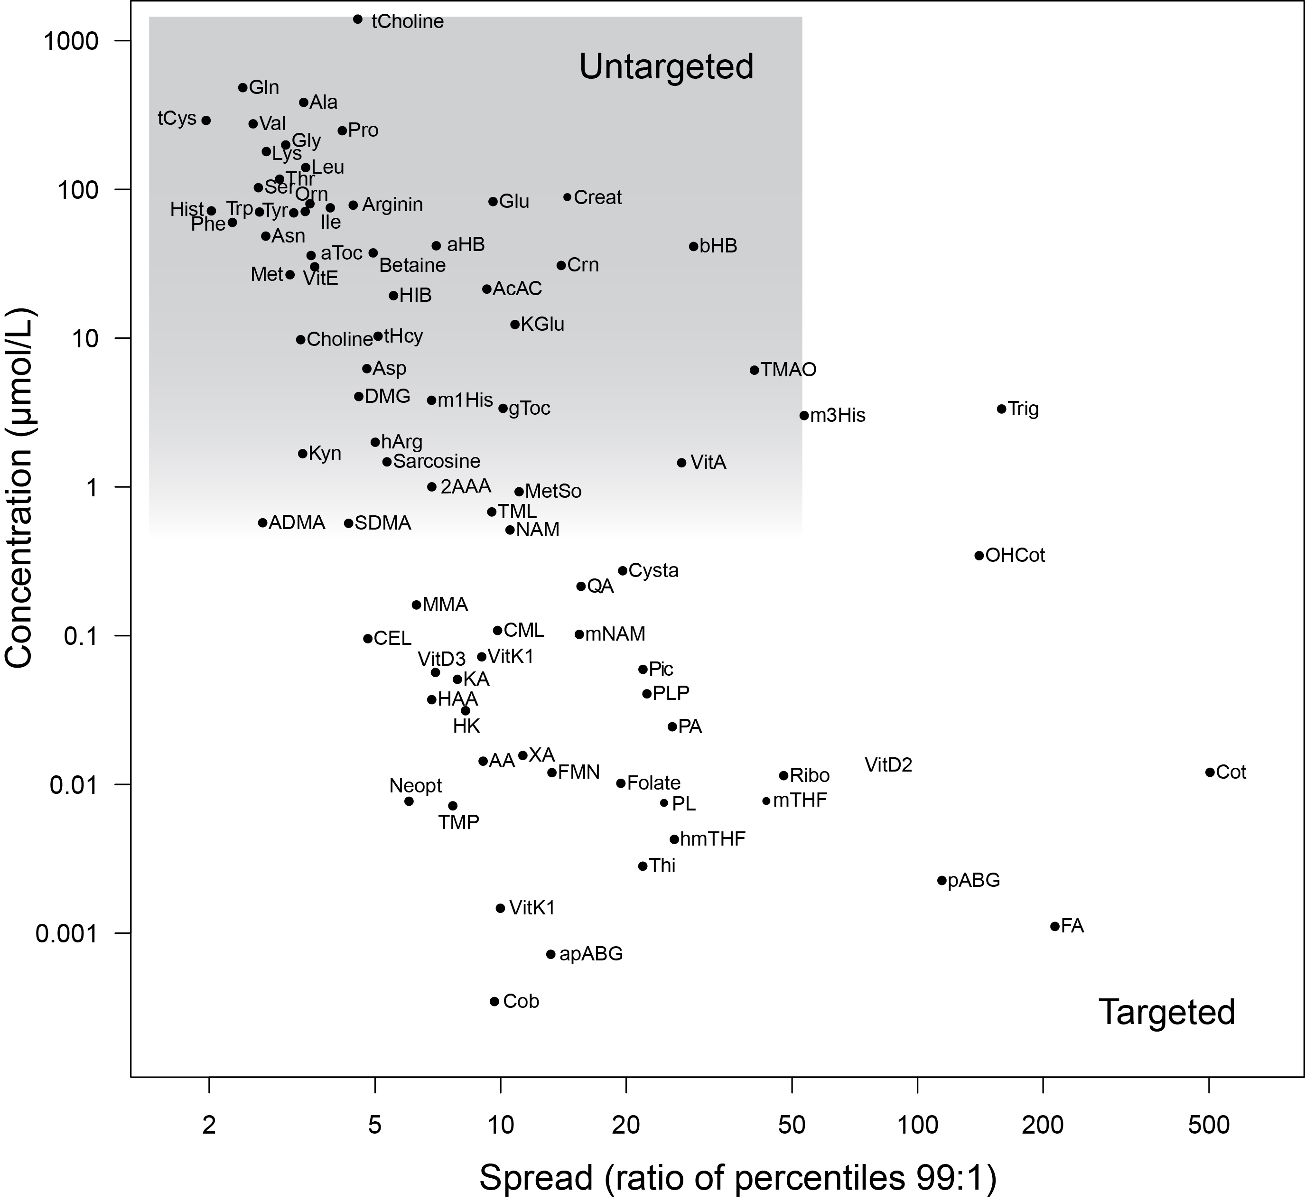
Targeted versus untargeted metabolomics

Slide 14
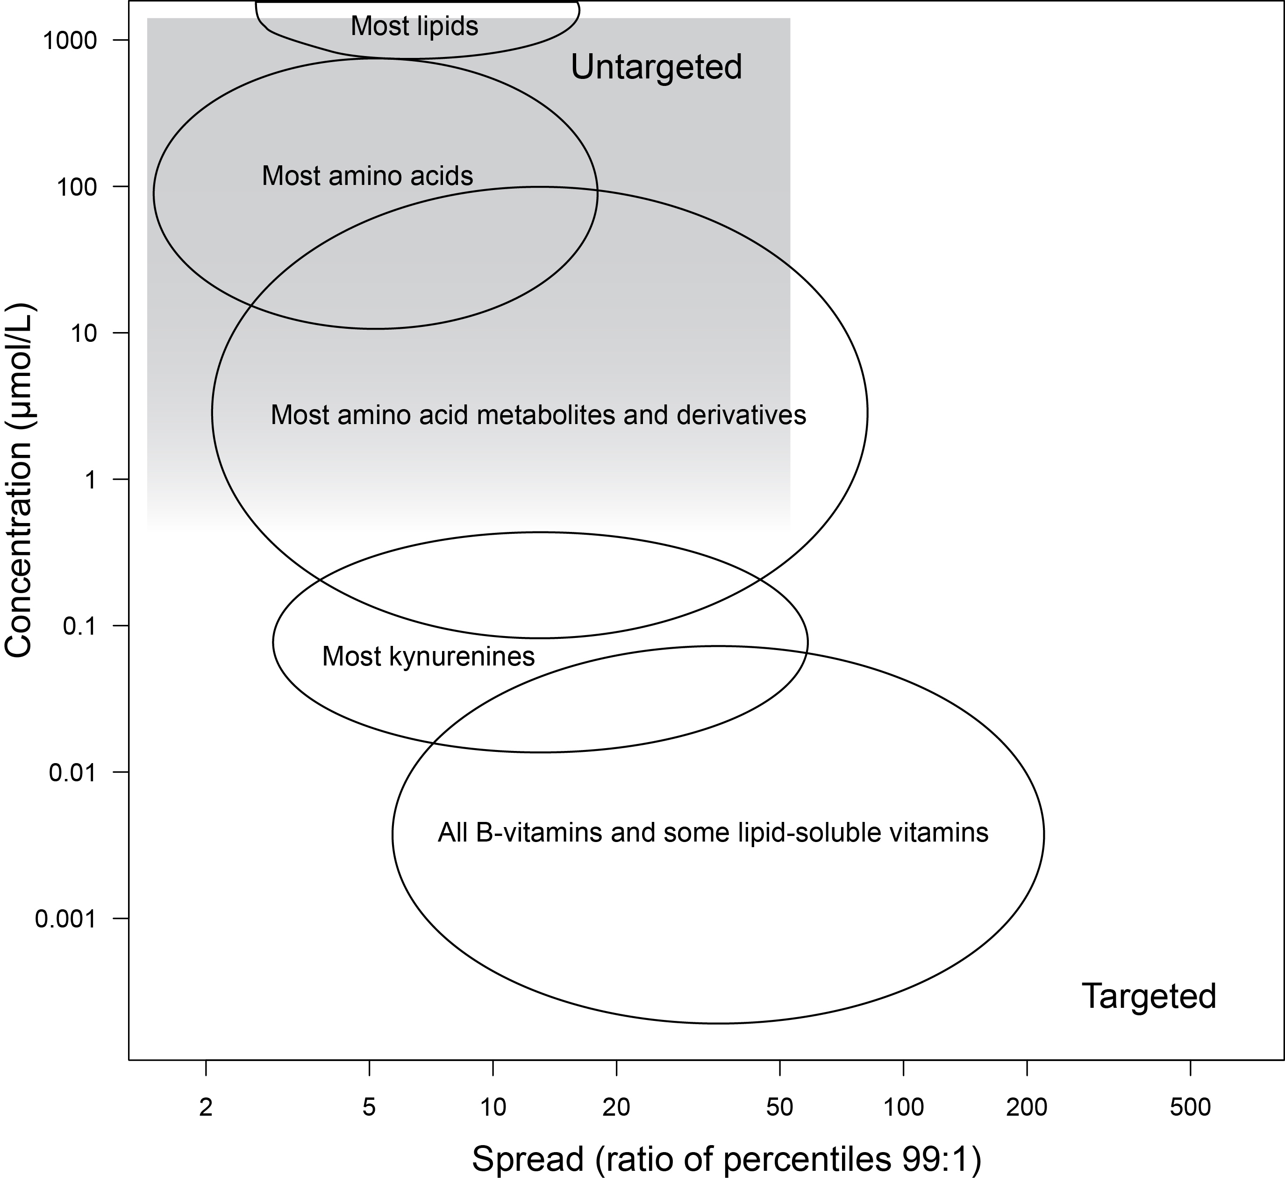
Targeted versus untargeted metabolomics

Slide 15
4. Authentic internal standards

Slide 16
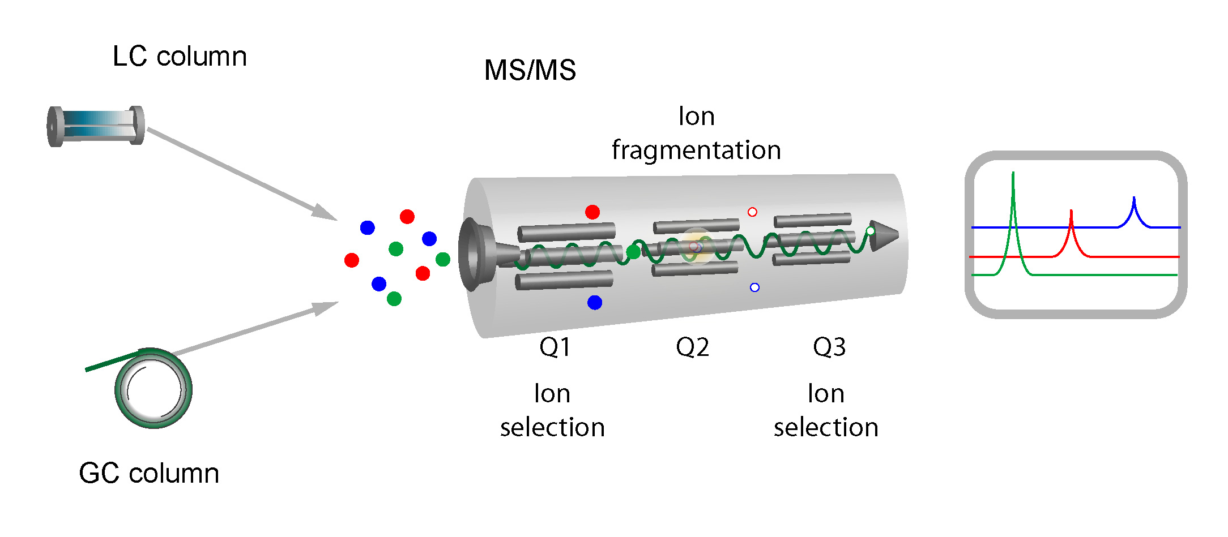
Mass spectrometry

Slide 17
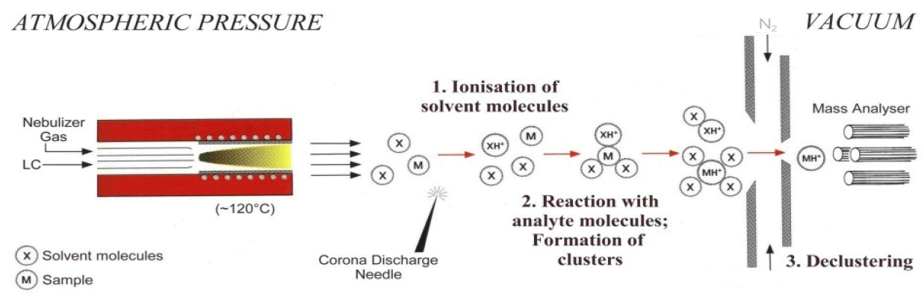
Electrospray Ionisation (ESI) and Atmospheric
Pressure Chemical Ionization (APCI)
ESI
APCI

Slide 18
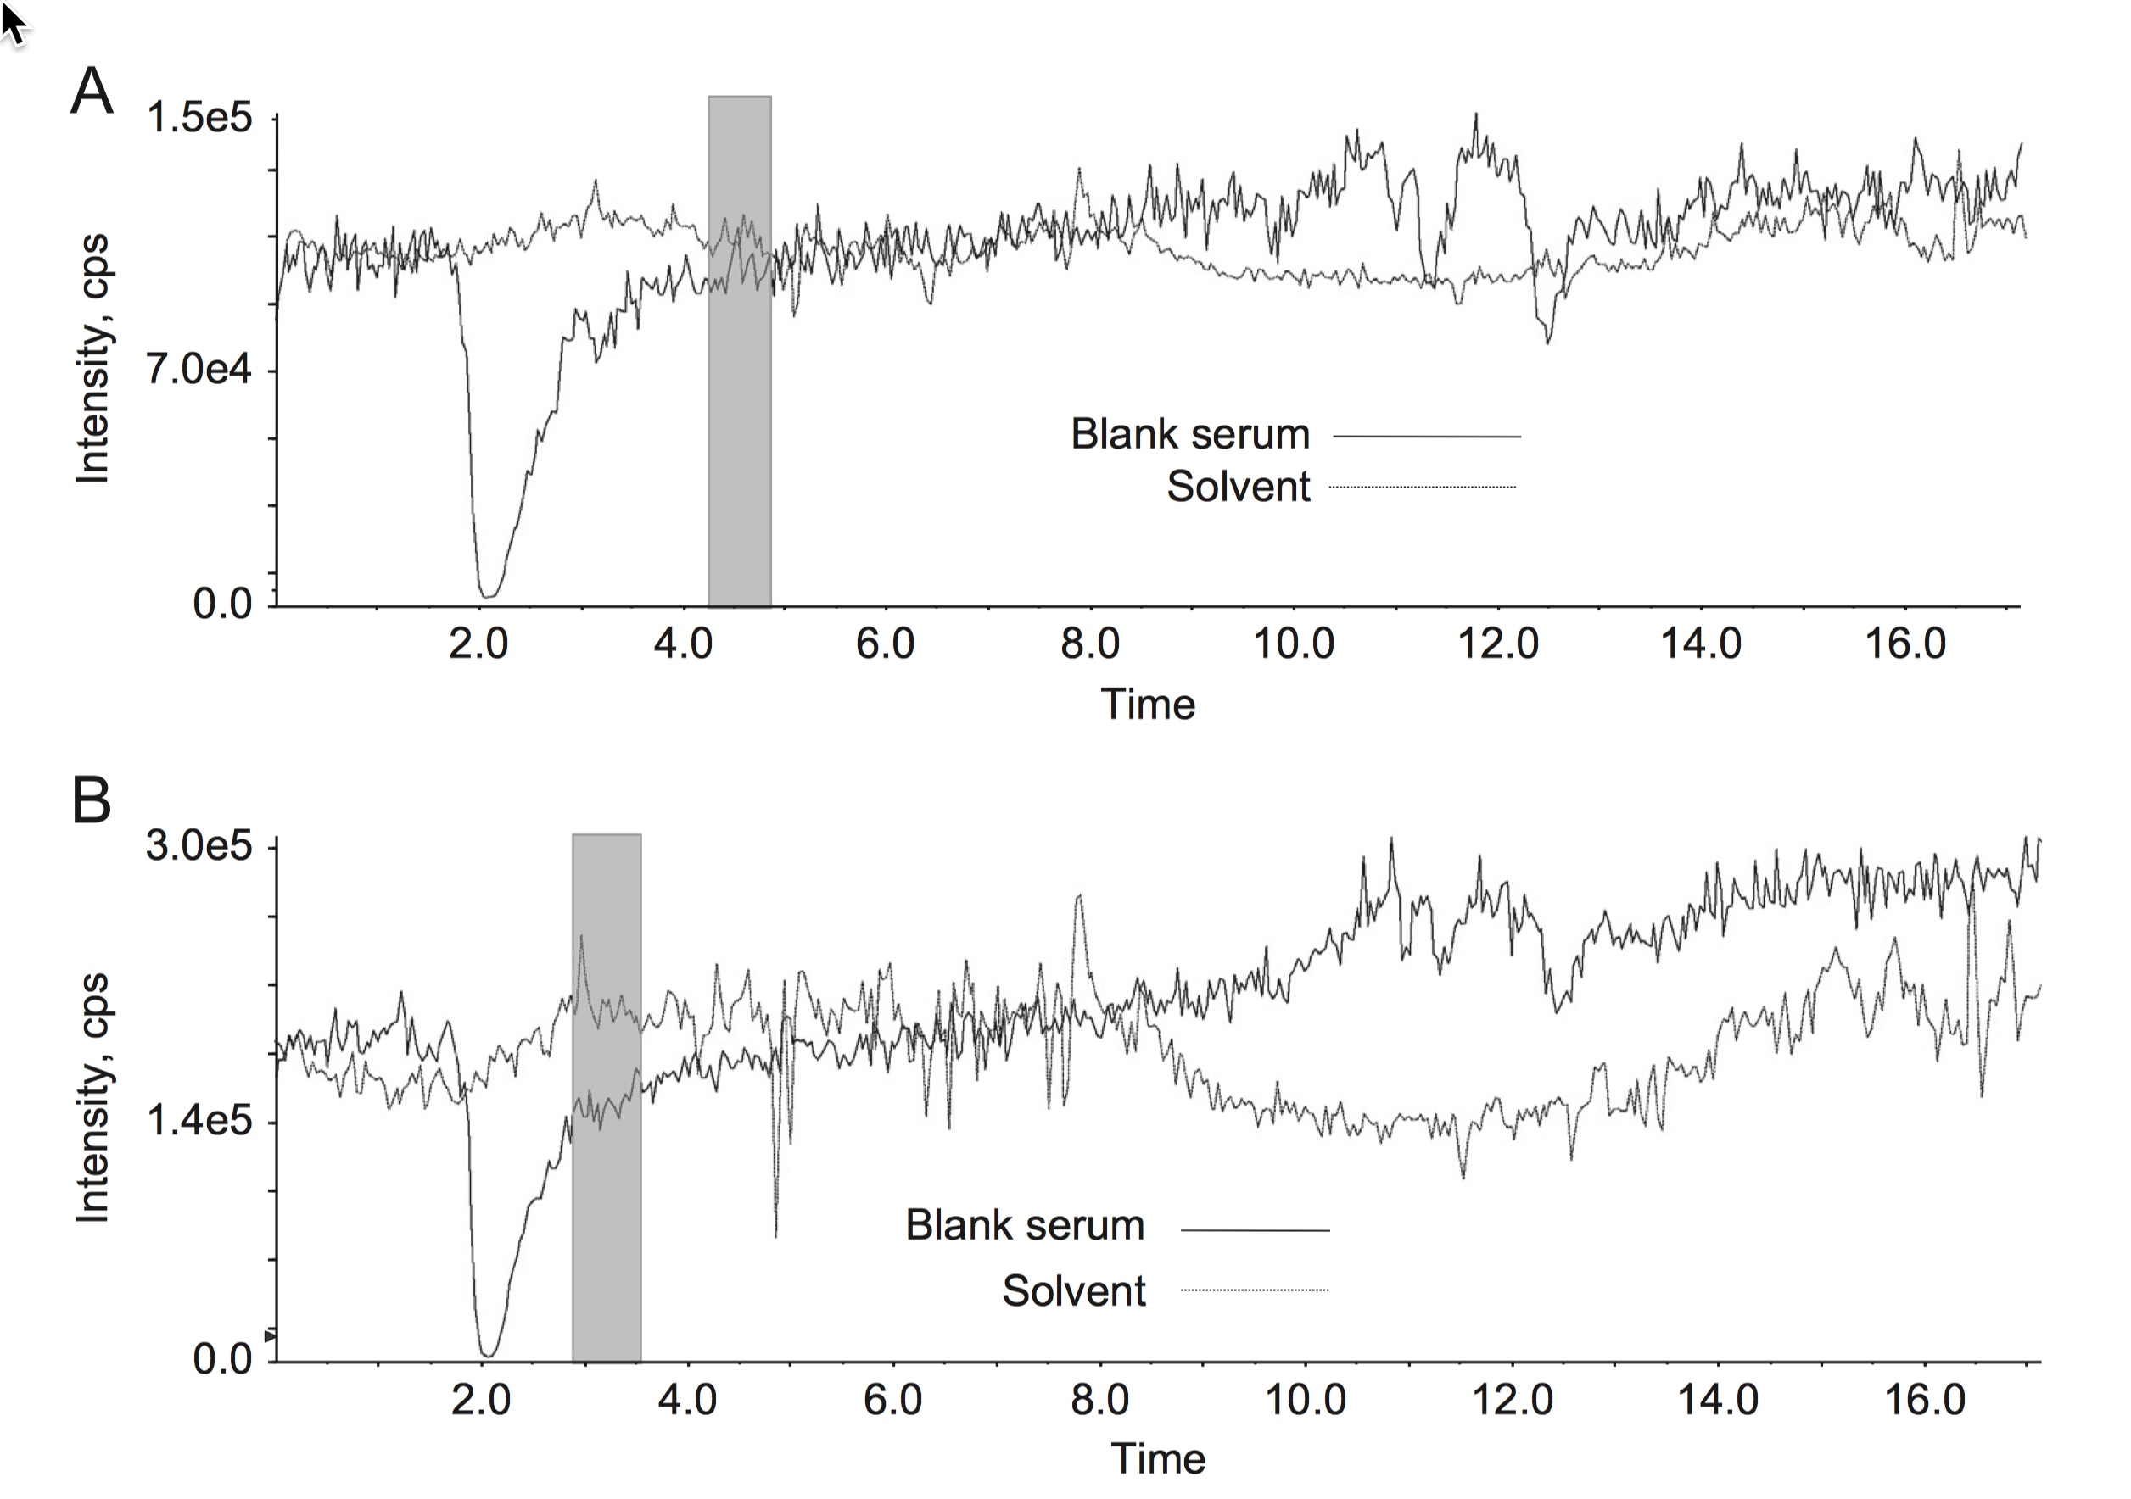
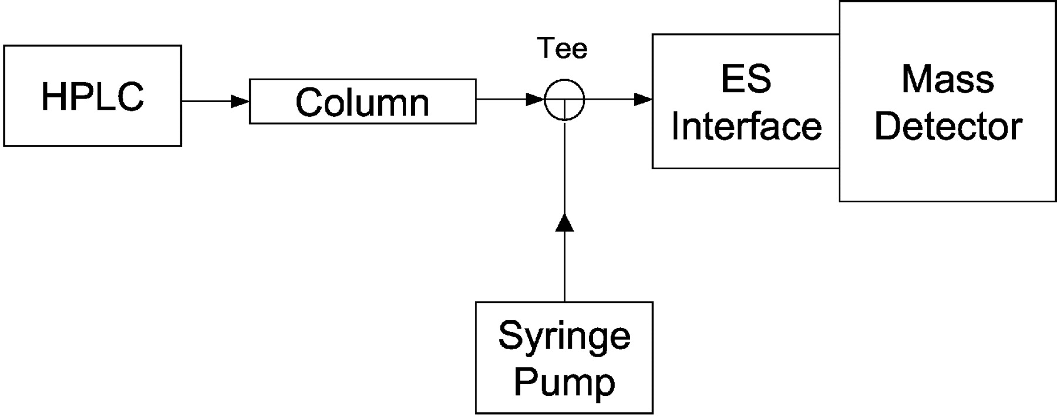
Ion suppression profiles of two compounds eluting at diffferent retention times by post-column infusion

Slide 19
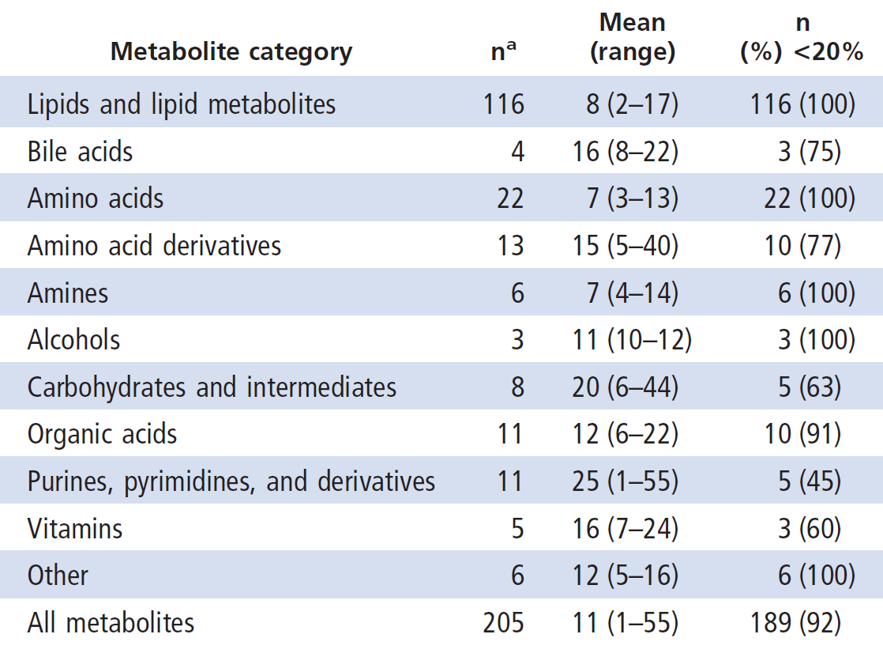
Between-day CVs published by a prestigious
metabolomics laboratory in US
Three platforms covering 257 metabolites, each platform incudes 1-3 internal standards; max retention times 18, 11 and 11 minutes.

Slide 20
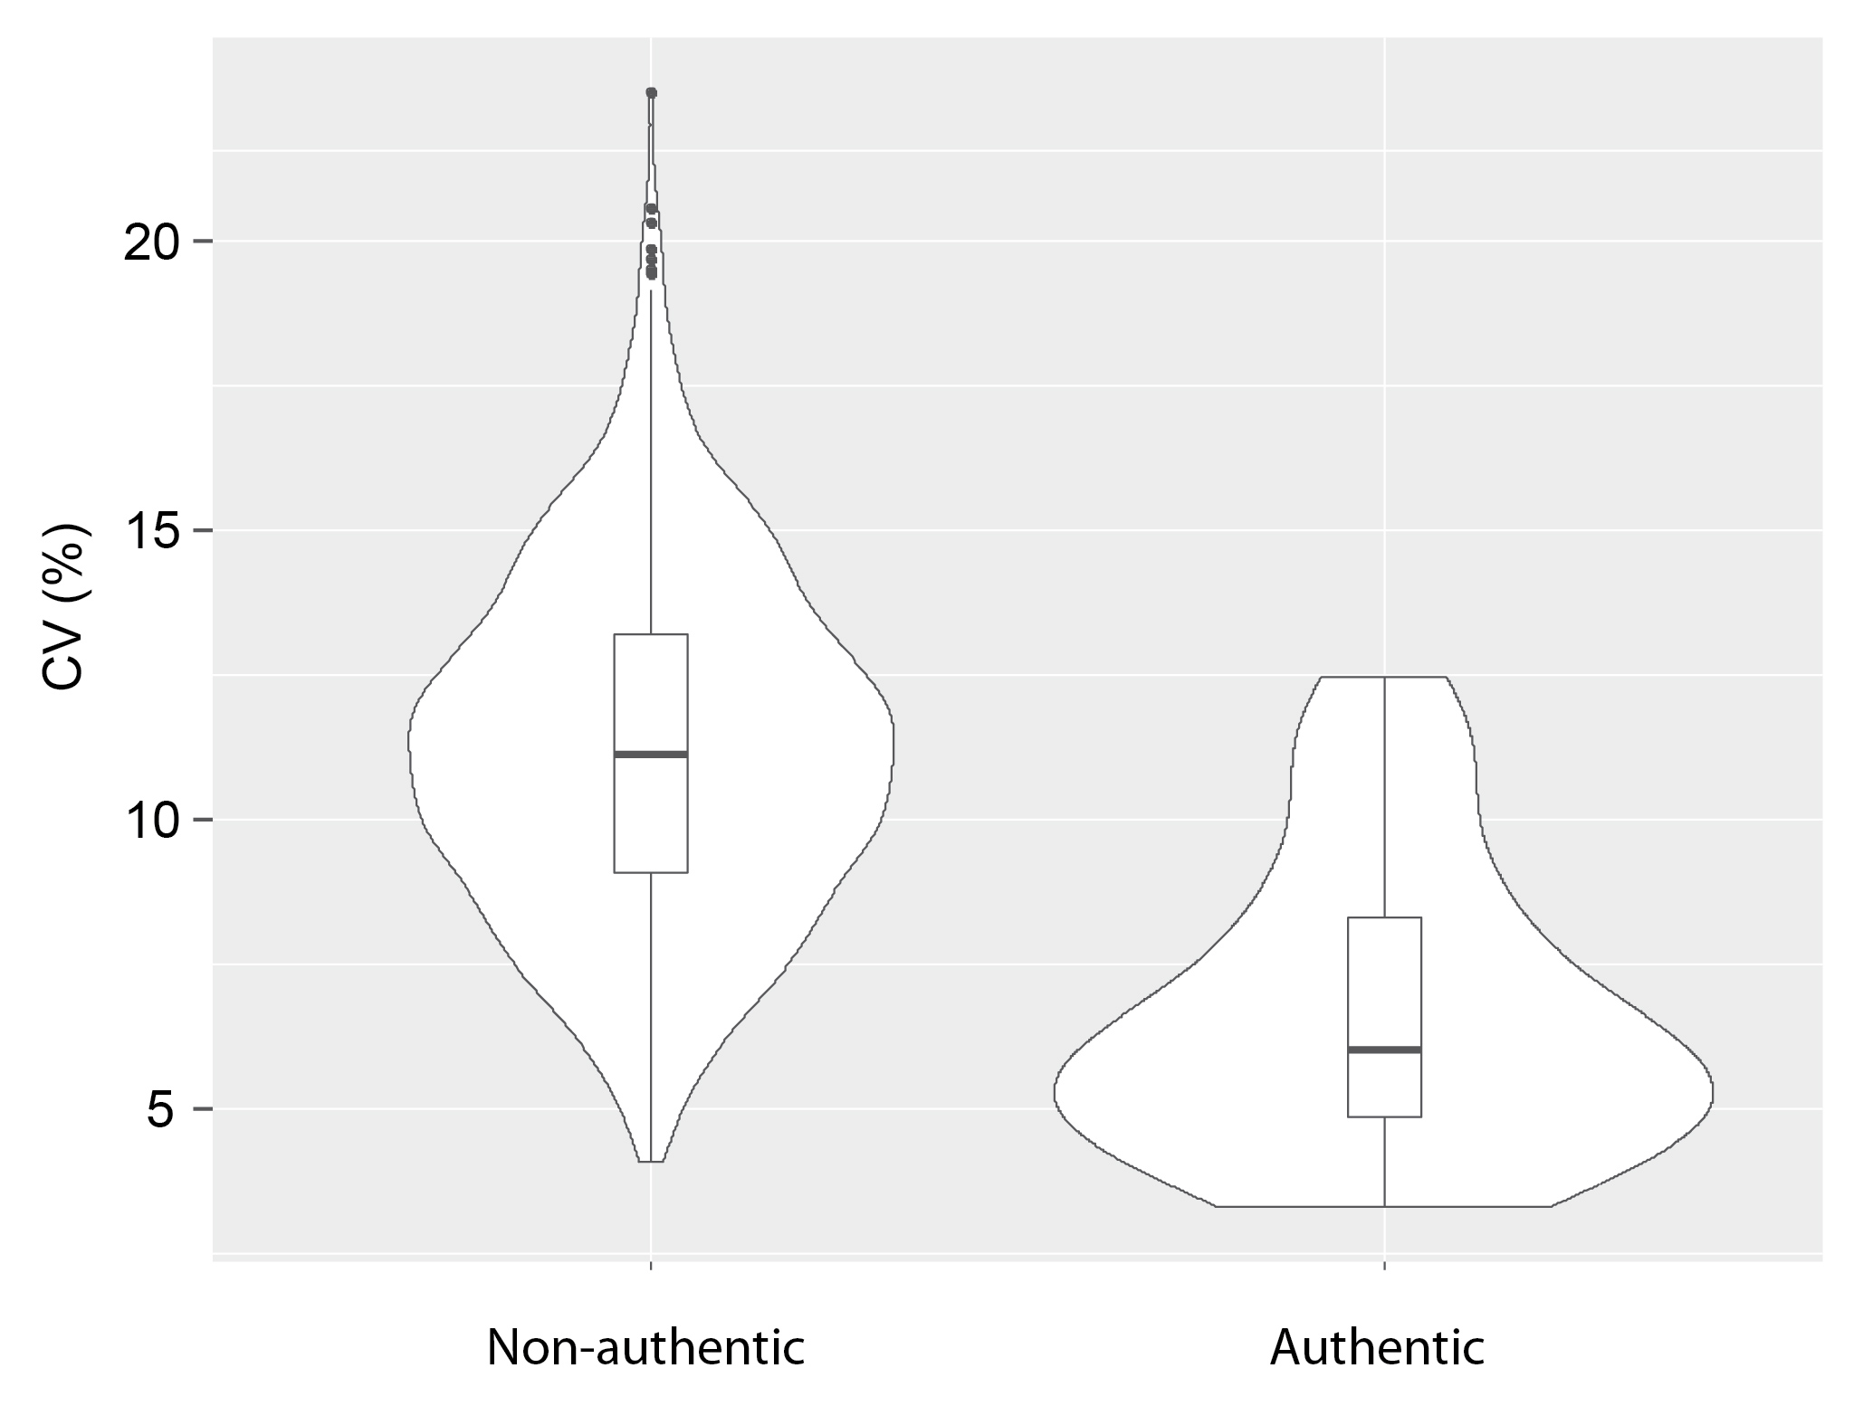
Precision with non-authentic or authentic internal standard (from Platform D)

Slide 21
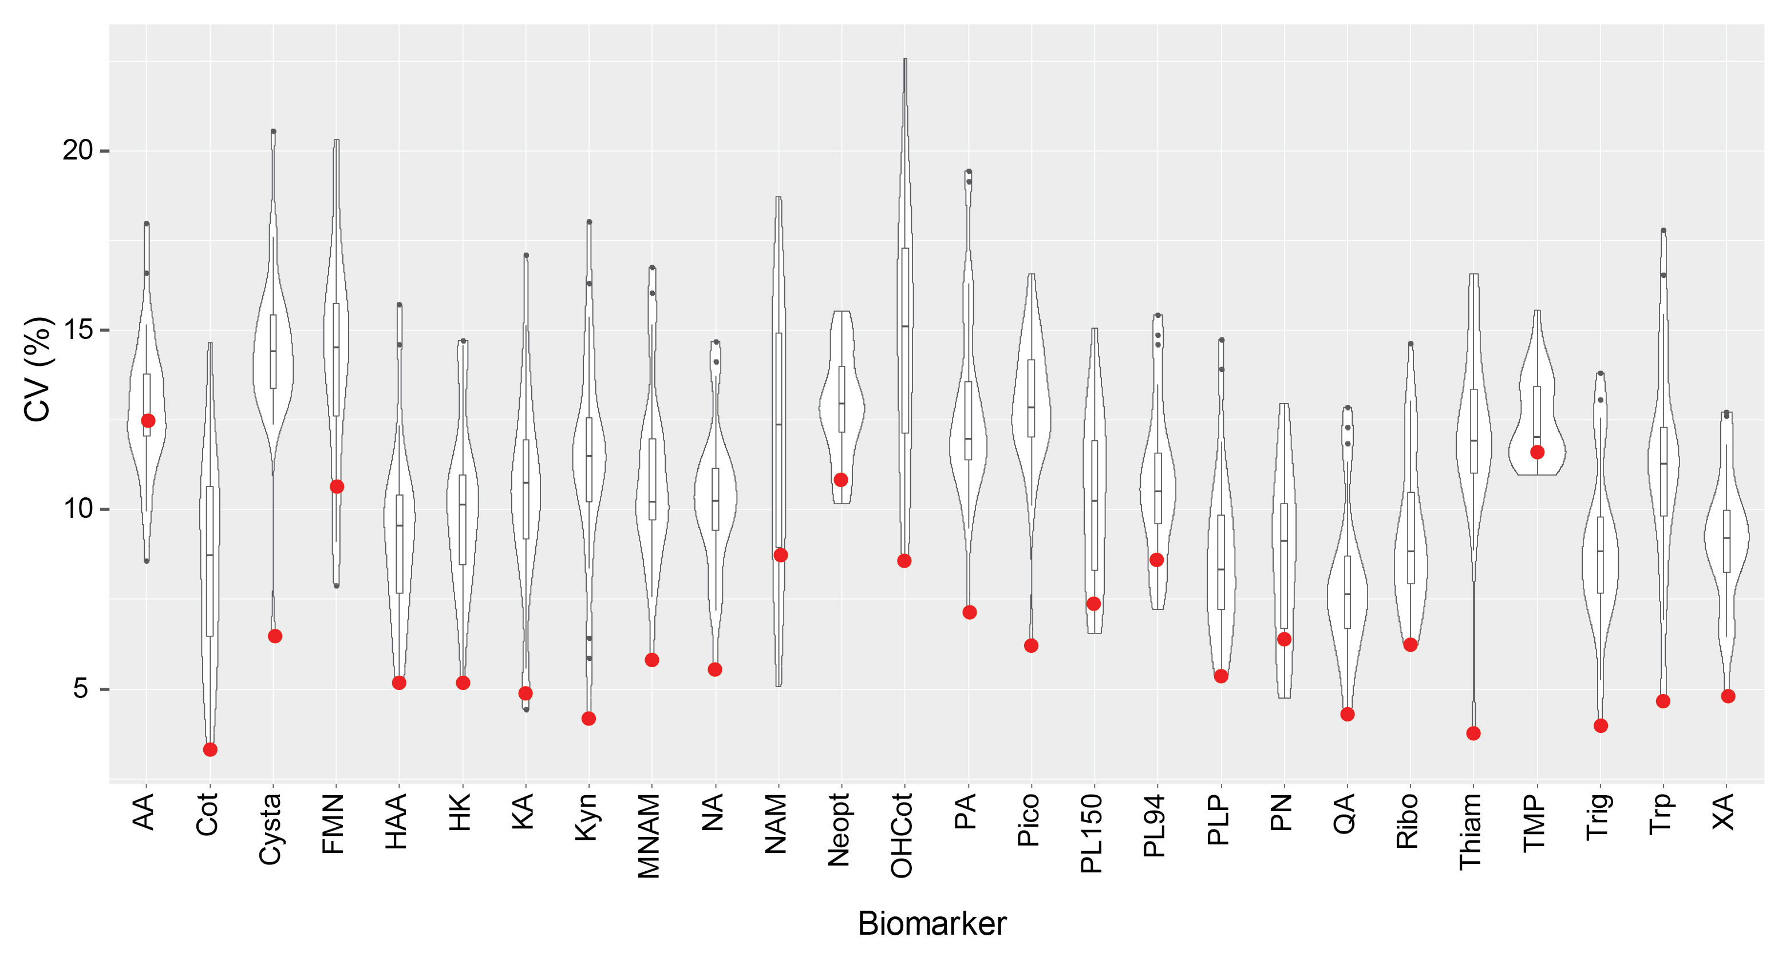
Precision with non-authentic or authentic internal standards across biomarkers
(example from Platform D)

Slide 22
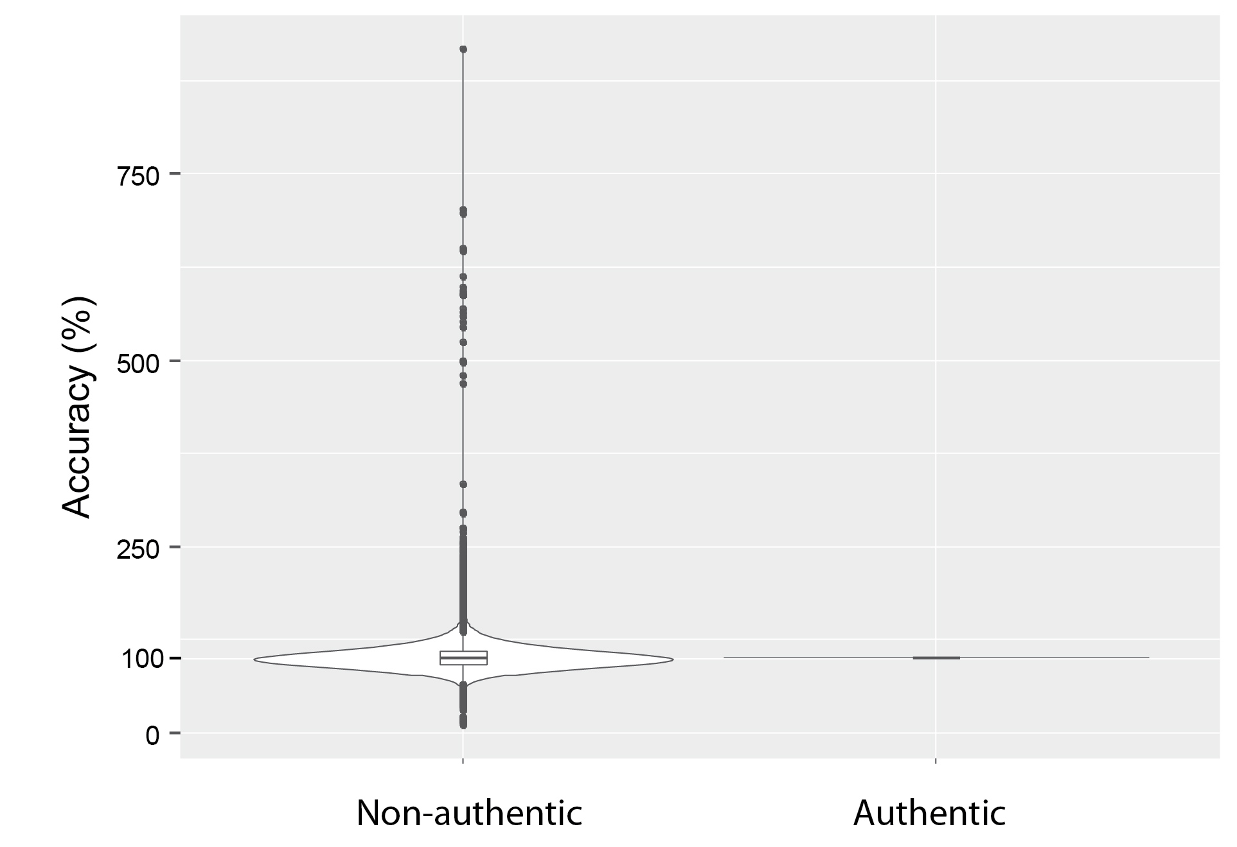
Accuracy with non-authentic or authentic internal standard (from Platform D)
About 50% of the samples have an accuracy between 90 and 110 % with non-authentic ISTD

Slide 23
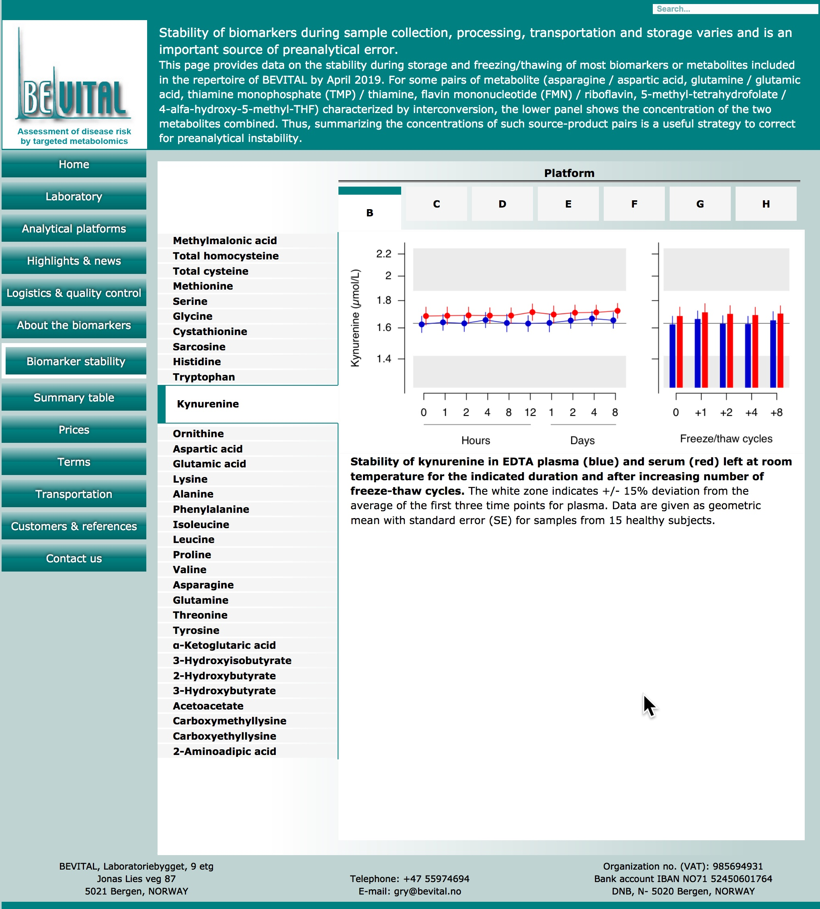
5. Preanalytical stability
https://folk.uib.no/mfapu/Pages/BV/BVSite/StabilityCurves.html
@
www.bevital.no

Slide 24
6. Intra-class correlation coefficient

Slide 25
Intraclass correlation coefficient
Numerous version of ICC have been proposed and the nomenclature is inconsistent and literature confusing.
Seminal papers: Shrout and Fleiss (1979) and McGraw and Wong
(1996).
For the assessment of biomarker reproducibility over time, Shrout and Fleiss ICC1 is recommended by Rosener (2006/2011).
The assumptions for ICC1 may be reasonable if there is only one observer taking replicated measurements.
ICC1 is based on a one-way random effects model ANOVA, with participant ID as the random variable, and measures absolute agreement and correlations of any two measurements (McGraw and Wong (1996).
The ANOVA model provides between-subject variance and within-subject variance, from which between subject CV and within subject CV (sqrt(var)*100) are calculated.

Slide 26
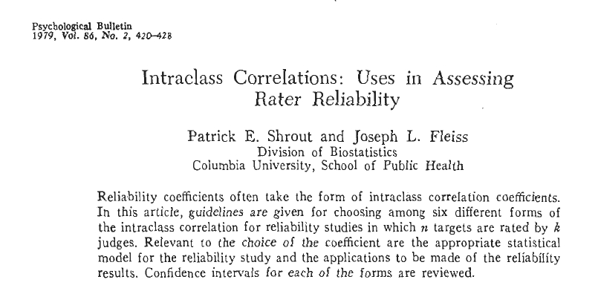
Intraclass correlation coefficient

Slide 27
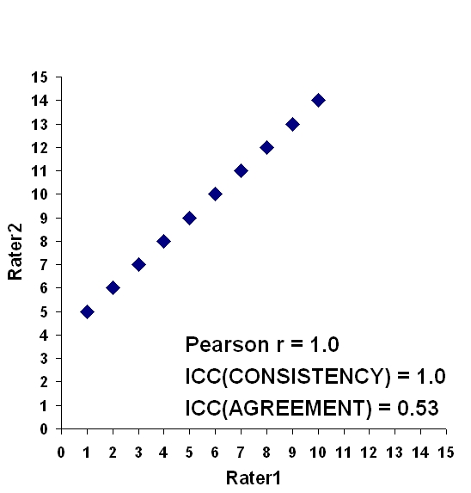
Intraclass correlation coefficient

Slide 28
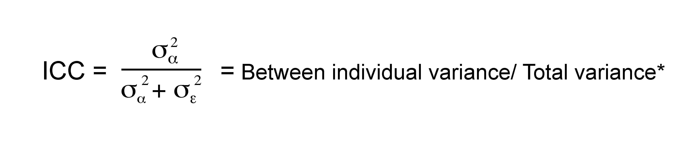
Within-subject reproducibility- Intraclass correlation coefficient (ICC)
0-0.2, poor agreement
0.3-0.4, fair agreement
0.5-0.6, moderate agreement
0.7-0.8, strong agreement
>0.8, almost perfect agreement
*Variances by a random effects model, with participant ID as the random variable

Slide 29
Intraclass correlation coefficient
For the assessement of
Stability
Reliability

Slide 30
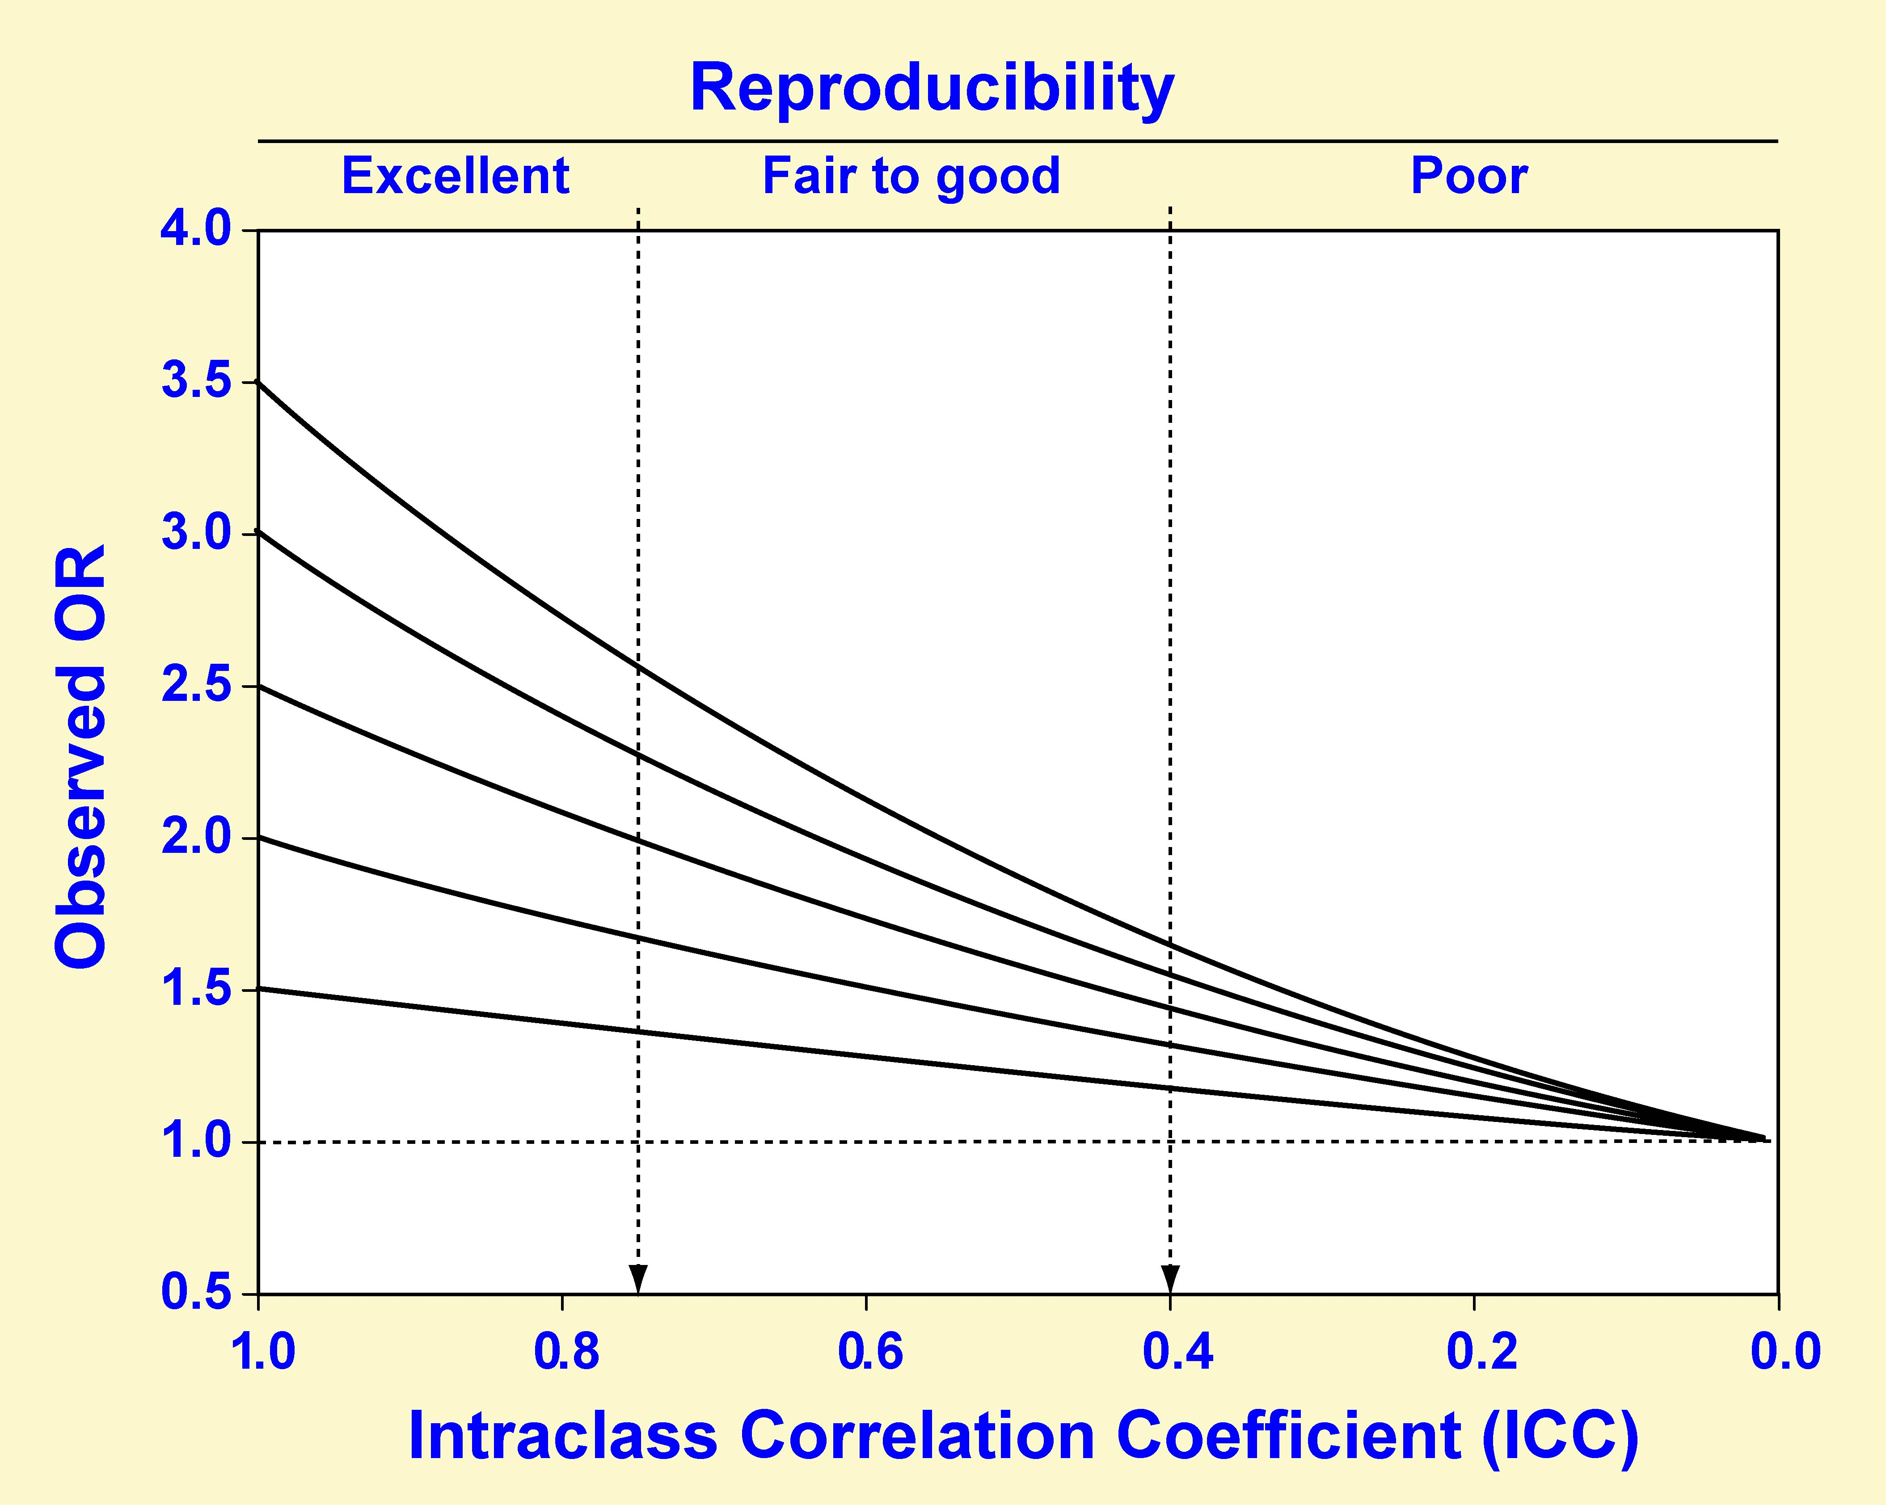
Impact of the ICC on the observed OR given true ORs for disease of 1.5, 2.0, 2.5, and 3.0.

Slide 31
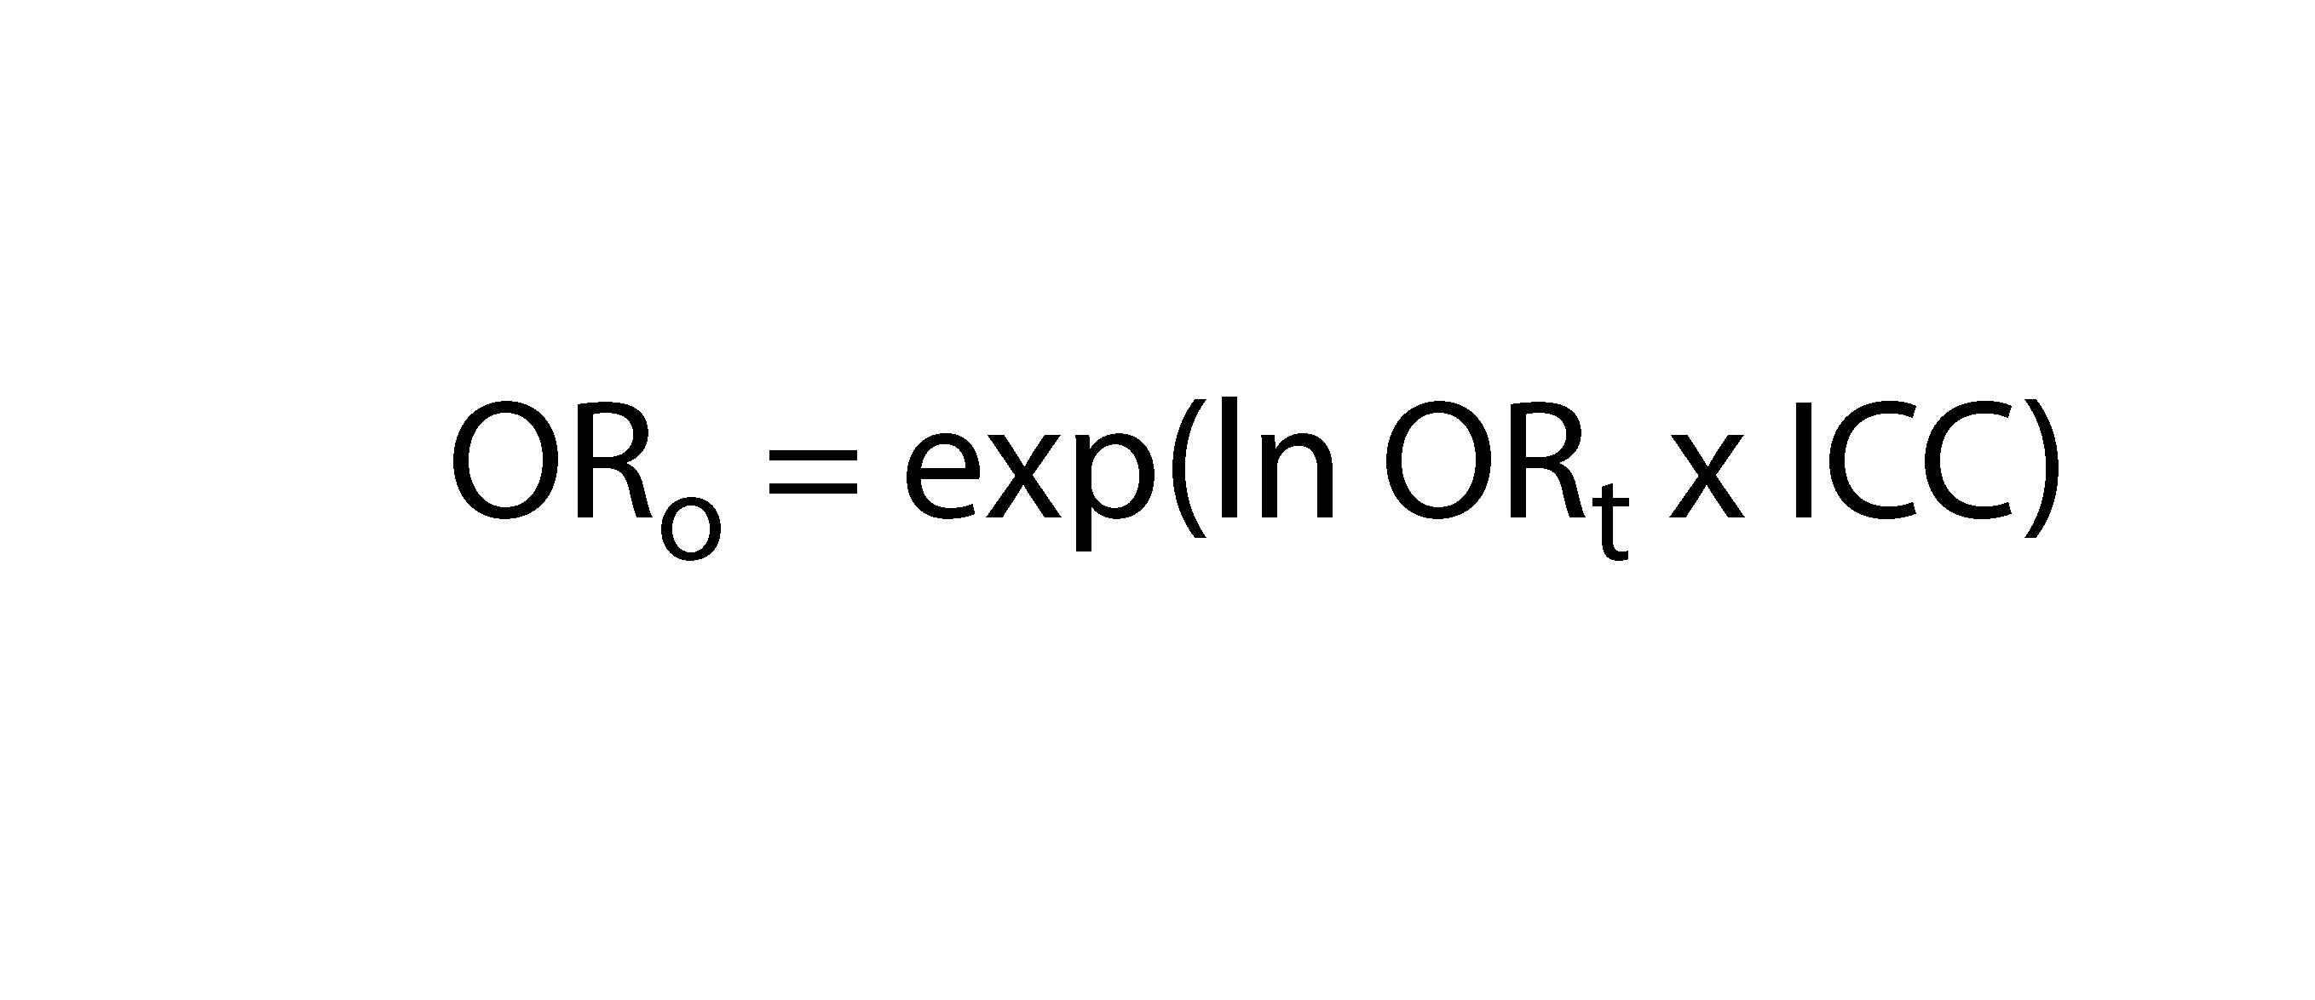
Observed OR (ORo) as a function of true OR (ORt) and ICC

Slide 32
7. Pathways and metabolite networks

Slide 33
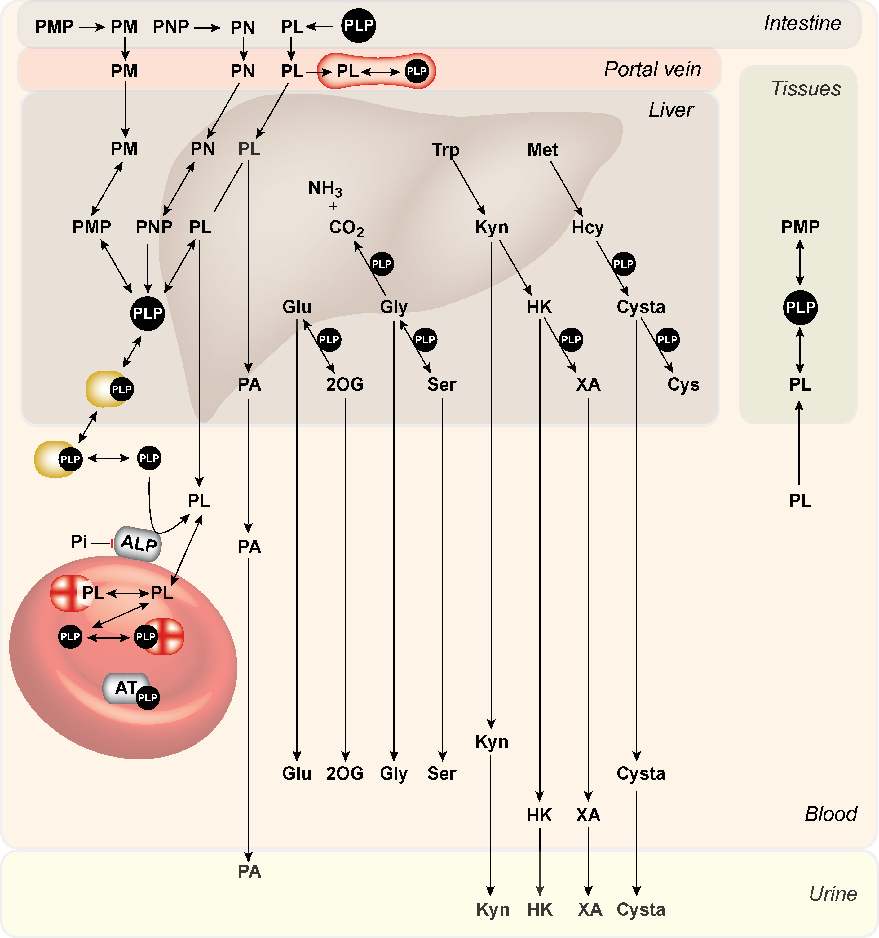
Pathways and metabolite networks

Slide 34
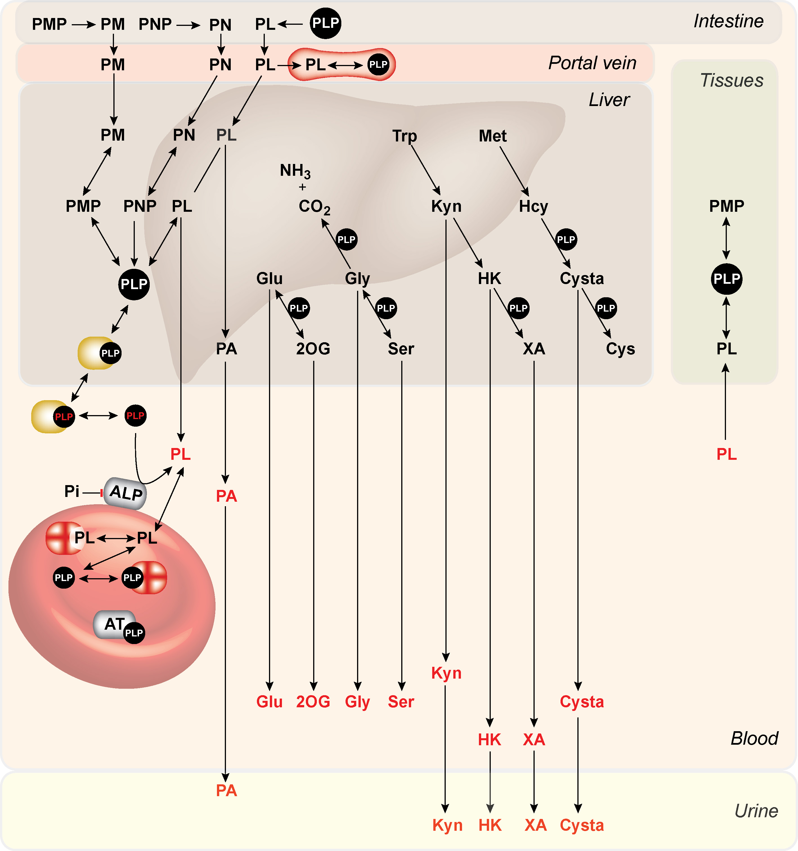
Pathways and metabolite networks

Slide 35
The kynurenine pathway:
A unique target
for
studying multimorbility

Slide 36
The kynurenine pathway:
A unique target
for
studying multimorbility

Slide 37
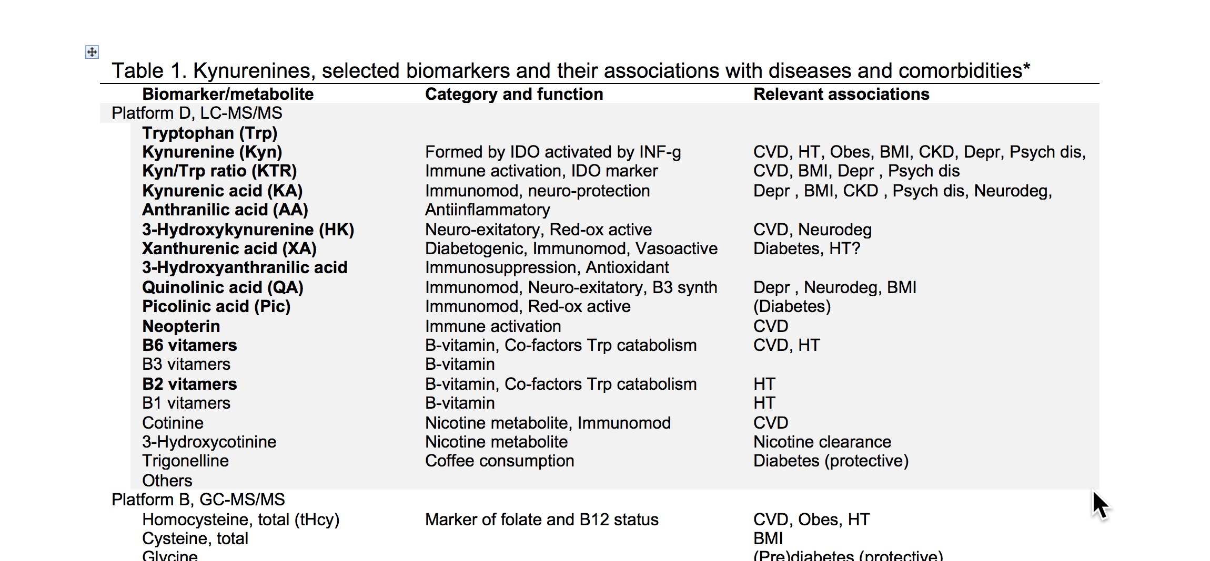
Association of kynurenine with
Cardiovascular disease and comorbidities

Slide 38
Useful concepts based on pathway analysis
KTR = [Kyn]/[Trp]
Marker of IDO activity and cellular immune activation
PAr-index = [PA]/([PLP]+[PL])
Inflammatory marker that reflect increased B6 catabolism
HK:XA = [HK]/[XA]
Functional marker of B6 status
HKr = [HK]/([KA]+[AA]+[XA]+[HAA])
Functional marker of B6 status with improved specificity

Slide 39
8. Common confounders

Slide 40
Common confounders
Smoking
- Cotinine (D)
- Trans-3'-hydroxycotinine (D)
Renal function
- Creatinine (C)
- Cystatin C and variants (G)
- SDMA (C)
Inflammation
- mCRP (G)
- Calprotectin and isoforms (G)
- Serym amyloid A and isoforms (G)
- Neopterin (D)
- KTR (kynurenine/tryptophan ratio) (D)
- PAr index (D)
Coffee consumption
- Trigonelline (D)
Meat consumption
- 3-Methylhistidine (C)
- 1-Methylhistidine (C)
Long-term glycaemic control
- HbA1c (G)

Slide 41
Conclusion
Targeted metabolic profiling (metabolomics) for accurate and precise measurements that include low abundance metabolites
Knowledge on preanalytical stability is paramount
Adequate within-subject reproducibility (ICC>>0.3) to minimize regression dilution bias
Analyses covering whole pathway allows mechanistic inference
Clinical/epidemiological studies should include data on common confounders

Slide 42
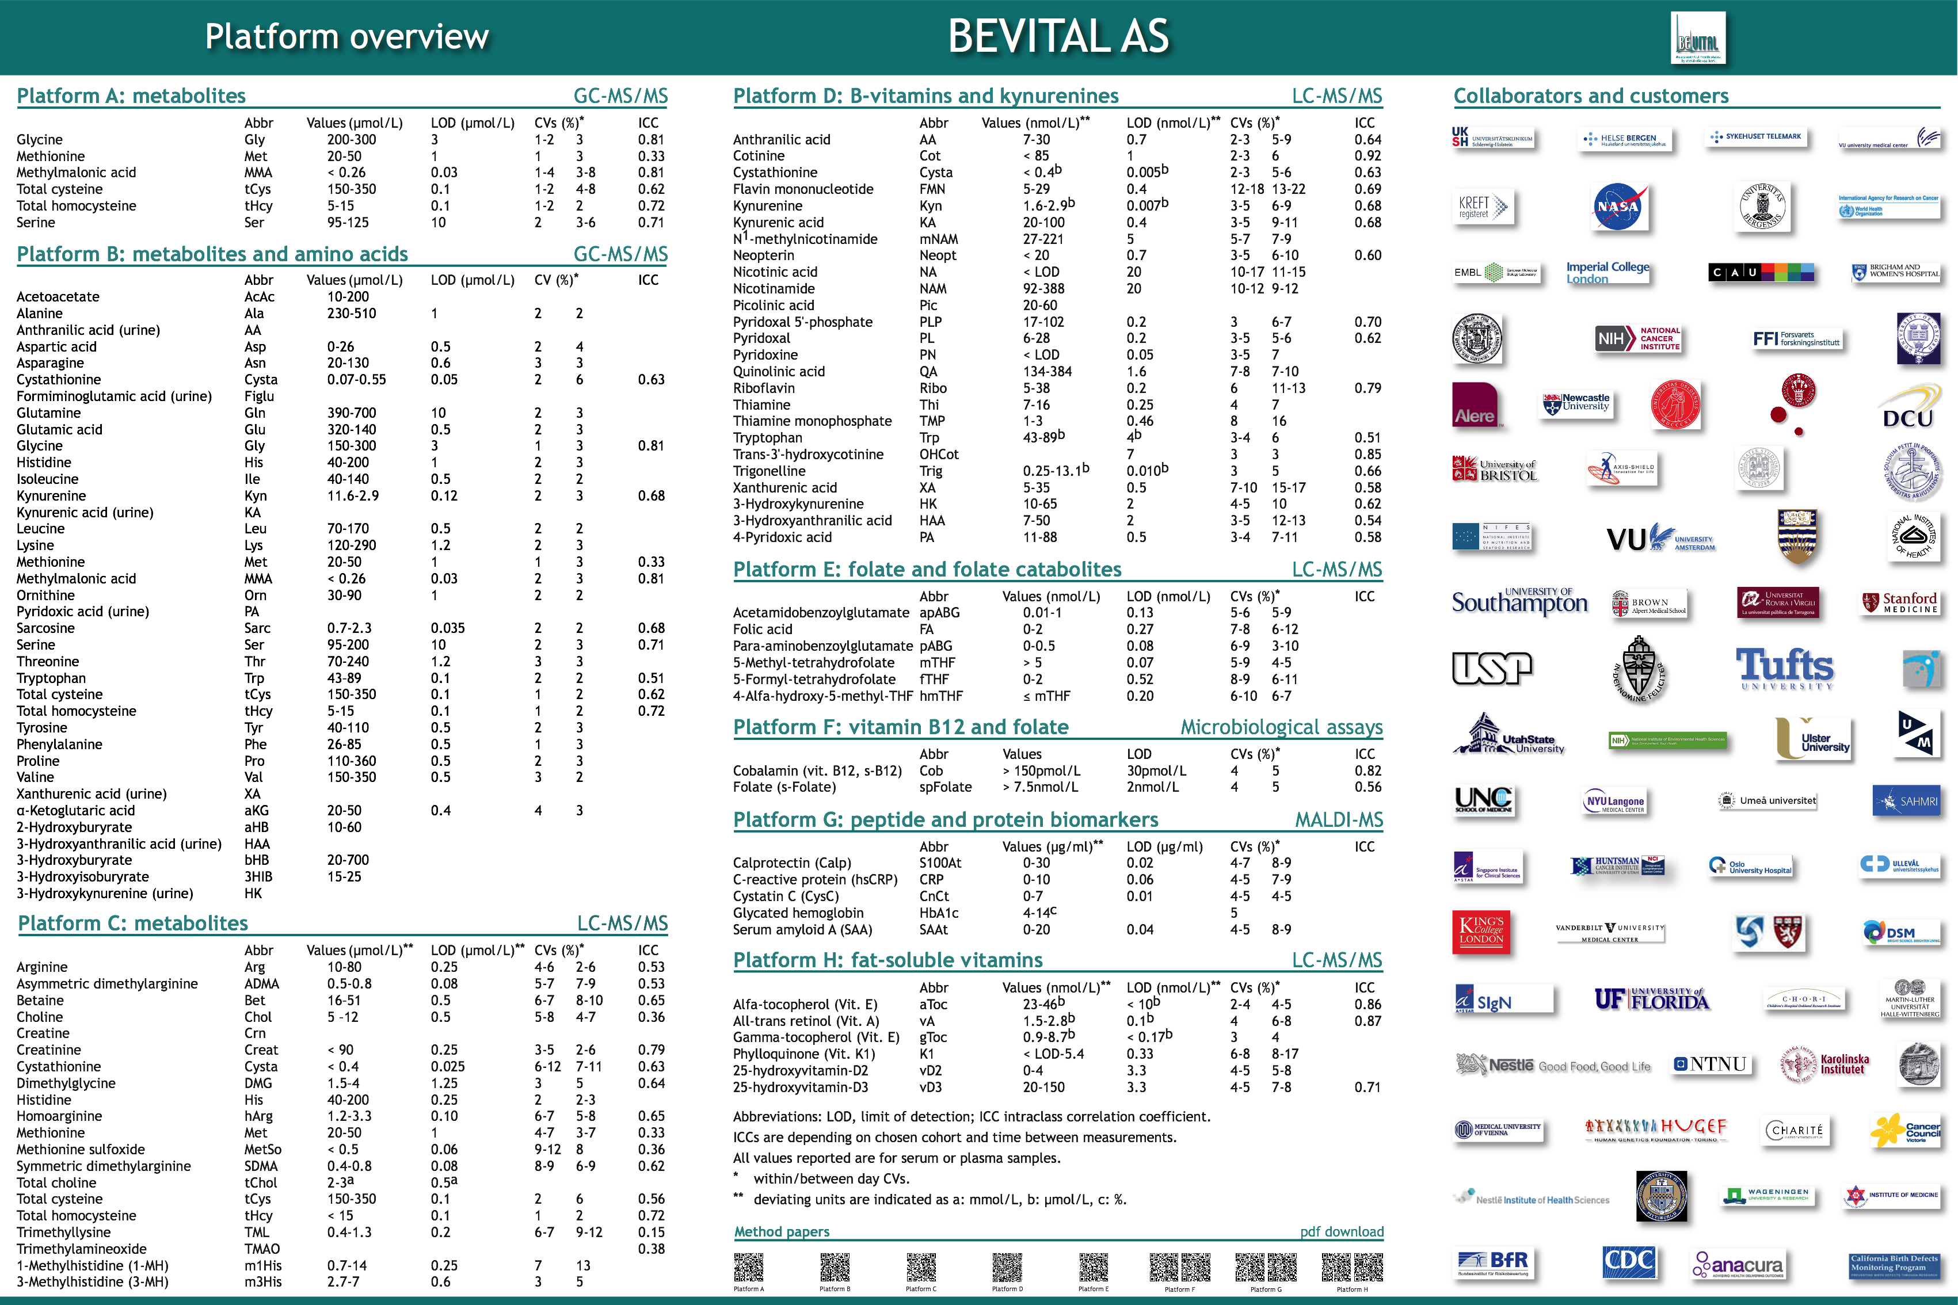

Slide 44
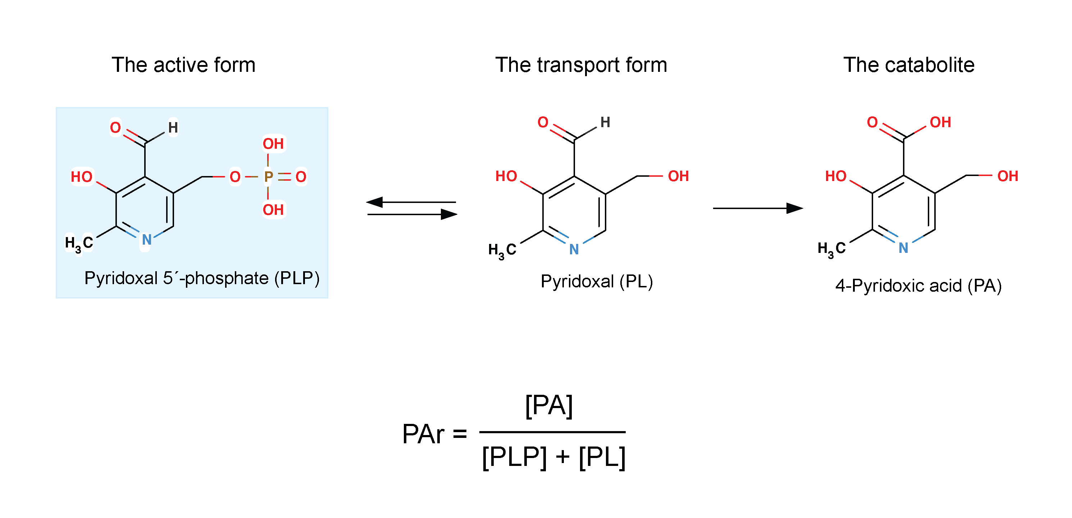
Unique biomarkers and concepts:
The PAr index

Slide 45
The vitamer B6 ratio, PAr
PAr = PA/(PLP+PL)
PAr has a higher ICC (of 0.75) than any other ratio and B6 vitamer
Inflammatory markers (CRP +WBC+KTR+neopterin) accounted for > 90% of the explained variance of PAr.
In ROC analysis, PAr discriminated high inflammatory levels assessed by a summary score (>95th percentile) with an area under the curve of 0.85.
Change in PAr over 28 days correlated with change in inflammatory markers over this time period

Slide 46
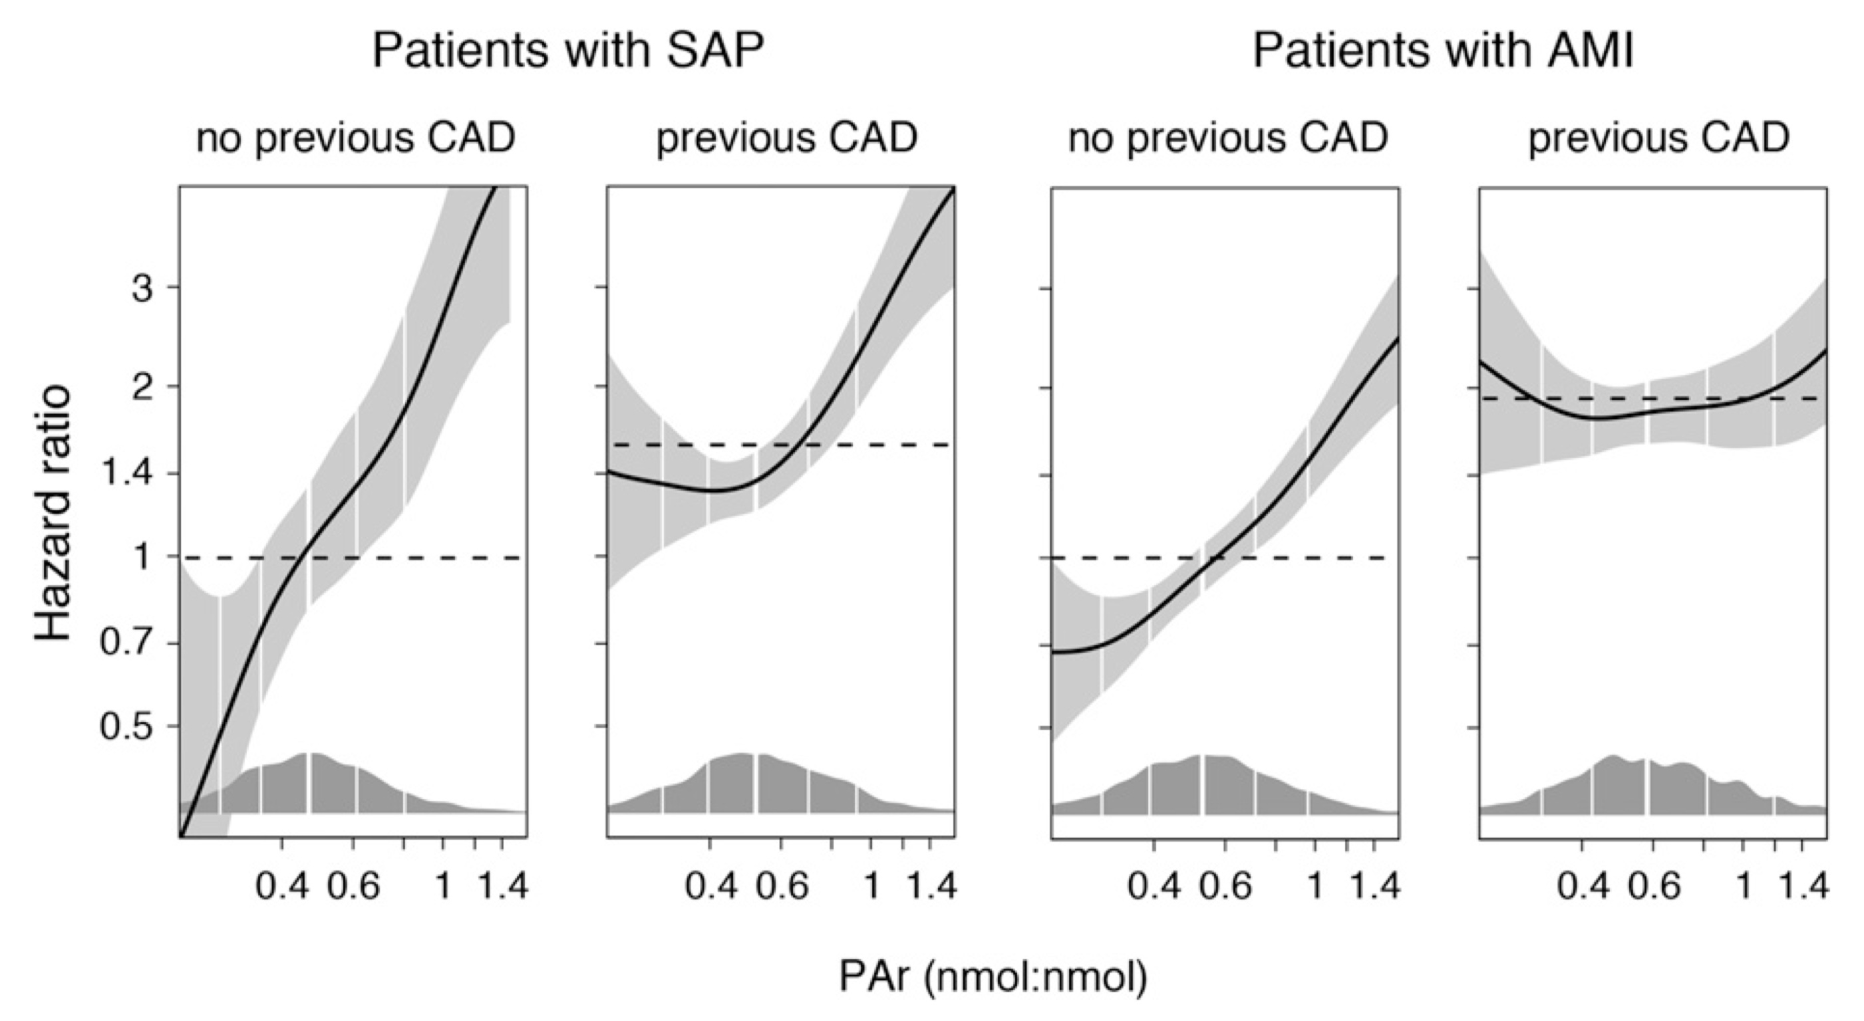
Vitamin B-6 catabolism and long-term mortality risk in patients with coronary artery disease
From: Ulvik et al (2016) Am J Clin Nutr 103: 1417

Slide 47
The PAr index as predictor of all-cause mortality in cardiovascular patients
Modified from: Ulvik et al (2016) Am J Clin Nutr 103: 1417

Slide 48
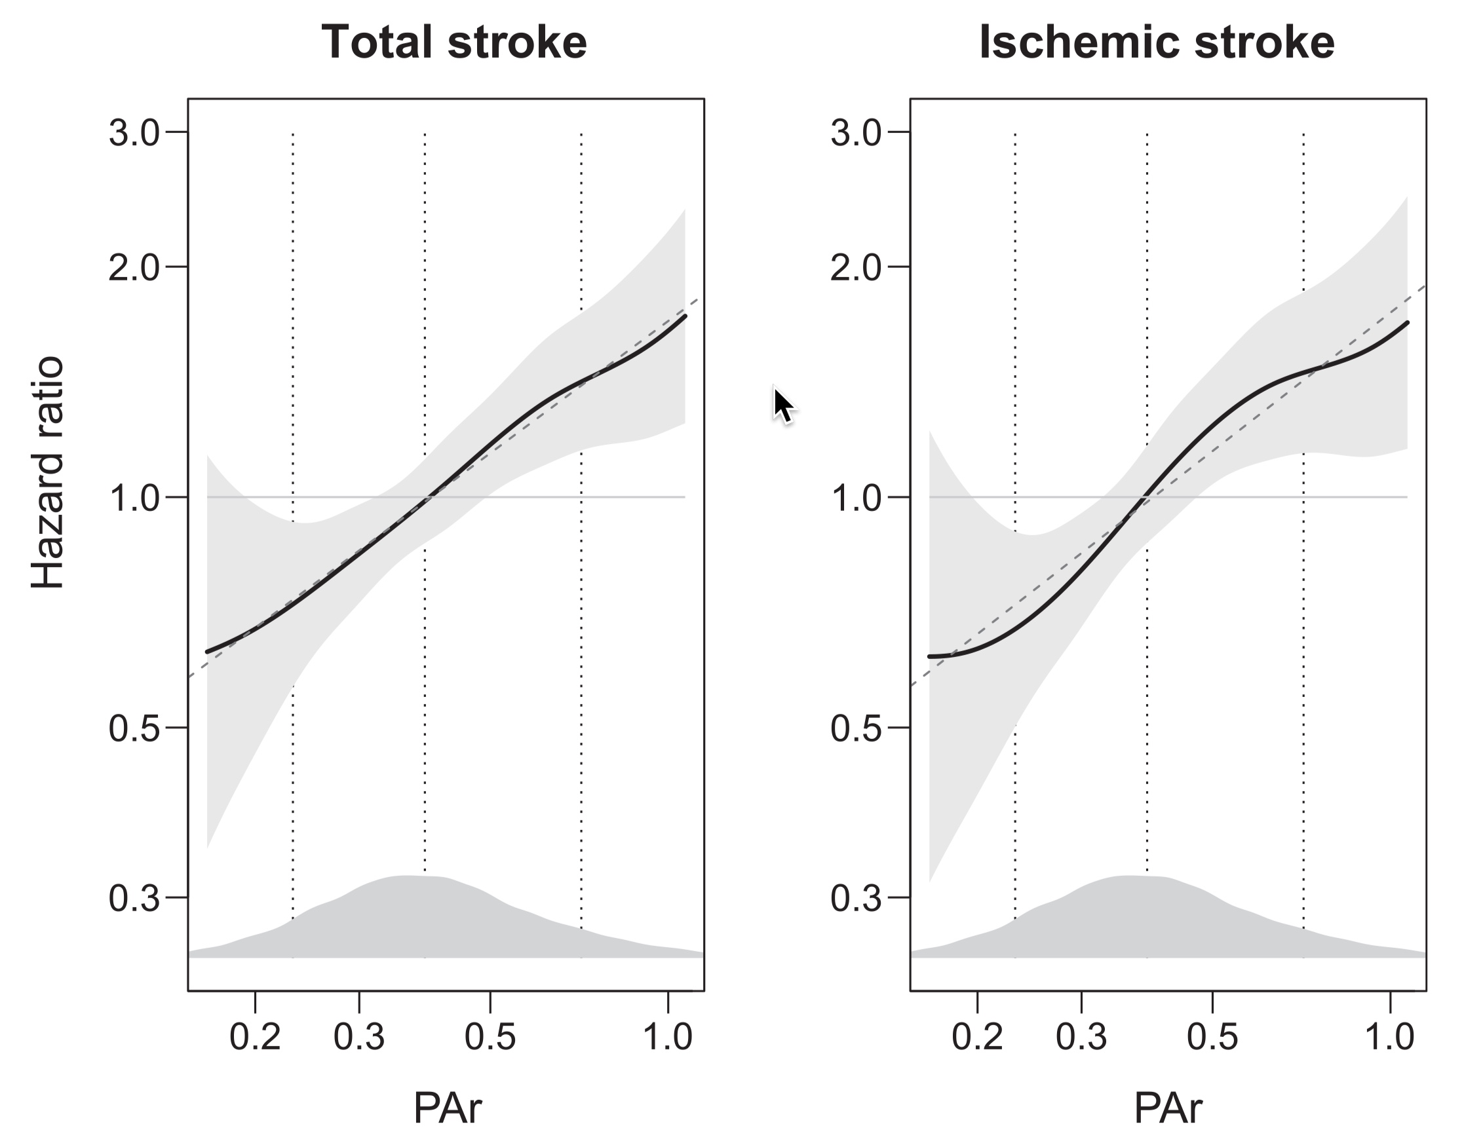
The PAr index is associated with long-term risk of stroke in the general population: the Hordaland Health Study (HUSK)
From: Zuo et al (2018) Am J Clin Nutr 107: 105

